Slide 1
20XC32
8086 Microprocessors

Slide 2
Assembler Directives
Instructions to the Assembler regarding the program being executed.
Control the generation of machine codes and organization of the program; but no machine codes are generated for assembler directives.
Also called ‘pseudo instructions’
Used to :
› specify the start and end of a program
› attach value to variables
› allocate storage locations to input/ output data
› define start and end of segments, procedures, macros etc..

Slide 3
Data Types and Data Definition
Assembler data directives
ORG (origin) – to indicate the beginning of the offset address ORG 0010H
DB (define byte) – allocation of memory in byte-sized chunks
Range : 00_{H} – FF_{H} for unsigned value; 00_{H} – 7F_{H} for positive value and 80_{H} – FF_{H} for negative value
DATA1 DB 25 ;decimal
DATA2 DB 10001001B ;binary
DATA3 DB 12H ;hex
DATA4 DB ‘2591’ ;ASCII numbers
DATA5 DB ? ;set aside a byte
DATA6 DB ‘Hello’ ;ASCII characters
DATA7 DB “O’ Hi” ;ASCII characters

Slide 4
Data Types and Data Definition
Assembler data directives
DUP (duplicate) – to duplicate a given number of characters
example:
DATA1 DB 0FFH, 0FFH, 0FFH, 0FFH ;fill 4 bytes with FF
Can be replaced with:
DATA2 DB 4 DUP(0FFH) ;fill 4 bytes with FF
DATA3 DB 30 DUP(?) ;set aside 30 bytes
DATA4 DB 5 DUP (2 DUP (99)) ;fill 10 bytes with 99

Slide 5
Data Types and Data Definition
DW (define word) – allocate memory 2 bytes (one word) at a time
example:
DATA1 DW 342 ;decimal
DATA2 DW 01010001001B ;binary
DATA3 DW 123FH ;hex
DATA4 DW 9,6,0CH, 0111B,’Hi’ ;Data numbers
DATA5 DW 8 DUP (?) ;set aside 8 words
EQU (equate) – define a constant without occupying a memory location
example:
COUNT EQU 25 ;COUNT can be used in many places in the program

Slide 6
Data Types and Data Definition
Assembler data directives
DD (define doubleword) – allocate memory 4 bytes (2 words) at a time
DATA1 DD 1023 ;decimal
DATA2 DD 01010001001001110110B ;binary
DATA3 DD 7A3D43F1H ;hex
DATA4 DD 54H, 65432H,65533 ;Data numbers
DQ (define quadwordequate) – allocate memory 8 bytes (4 words) at a time
DATA1 DQ 6723F9H ;hex
DATA2 DQ ‘Hi’ ;ASCII characters
DATA3 DQ ? ;nothing

Slide 7
Data Types and Data Definition
Assembler data directives
DT (define ten bytes) – allocates packed BCD numbers (used in multibyte addition of BCD numbers)
example:
DATA1 DT 123456789123 ;BCD
DATA2 DT ? ;nothing
DATA3 DT 76543d ;assembler will convert decimal number to hex and store it

Slide 8
The PTR Operator - Byte or word or double word?
INC [20h] ; is this byte/word/dword? or
• MOV [SI],5
– Is this byte 05?
– Is this word 0005?
– Or is it double word 00000005?
• To clarify we use the PTR operator
– INC BYTE PTR [20h]
– INC WORD PTR [20h]
– INC DWORD PTR [20h]
• or for the MOV example:
– MOV byte ptr [SI],5
– MOV word ptr[SI],5
13

Slide 9
The PTR Operator
• Would we need to use the PTR operator in each of the following?
MOV AL,BVAL
MOV DL,[BX]
SUB [BX],2
MOV AL,BVAL
MOV DL,[BX]
SUB [BX],byte ptr 2
MOV CL,byte ptr WVAL
ADD AL,BVAL+1
MOV CL,WVAL
ADD AL,BVAL+1
.data
BVAL DB 10H,20H
WVAL DW 1000H
14

Slide 10
Control transfer instruction

Slide 11
Iteration Control Instructions
These instructions are used to execute the given
instructions for number of times.
 LOOP − Used to loop a group of instructions until the
condition satisfies, i.e., CX = 0
 LOOPE/LOOPZ − Used to loop a group of
instructions till it satisfies ZF = 1 & CX = 0
 LOOPNE/LOOPNZ − Used to loop a group of
instructions till it satisfies ZF = 0 & CX = 0
 JCXZ − Used to jump to the provided address if CX =0

Slide 12
Iteration Control Instructions
Mnemonic | Meaning | Format | Operation
LOOP | LOOP | LOOP short-label | (CX)←(CX)-1 Jump to location defined by short-label if (CX) ≠ 0; otherwise, execute next instruction
LOOPE/ LOOPZ | Loop while equal/ loop while zero | LOOPE/LOOPZ short-label | (CX)←(CX)-1 Jump to location defined by short-label if (CX) ≠ 0; an d (ZF)=1; otherwise, execute next instruction
LOOPNE/ LOOPNZ | Loop while not equal/ loop while not zero | LOOPNE/LOOPNZ short-label | (CX)←(CX)-1 Jump to location defined by short-label if (CX) ≠ 0; and (ZF)=0; otherwise, execute next instruction
12

Slide 13
Conditional processing
If ..Then..else
While…Do
Repeat …Until

Slide 14
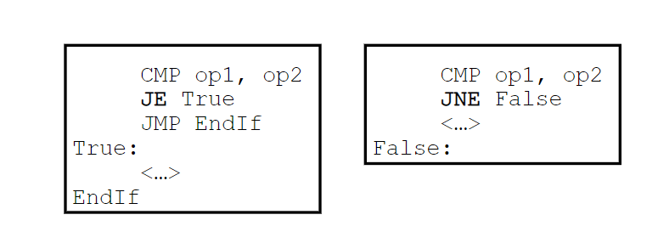
Simple IF
If(op1 =op2) then <….>endif
Two different approaches

Slide 15
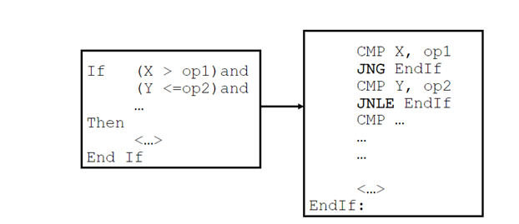
IF…AND…

Slide 16
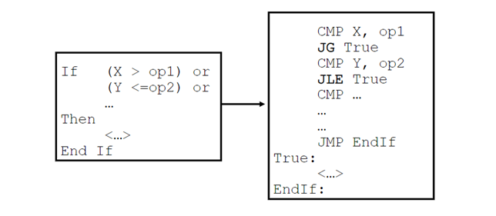
IF…OR….

Slide 17
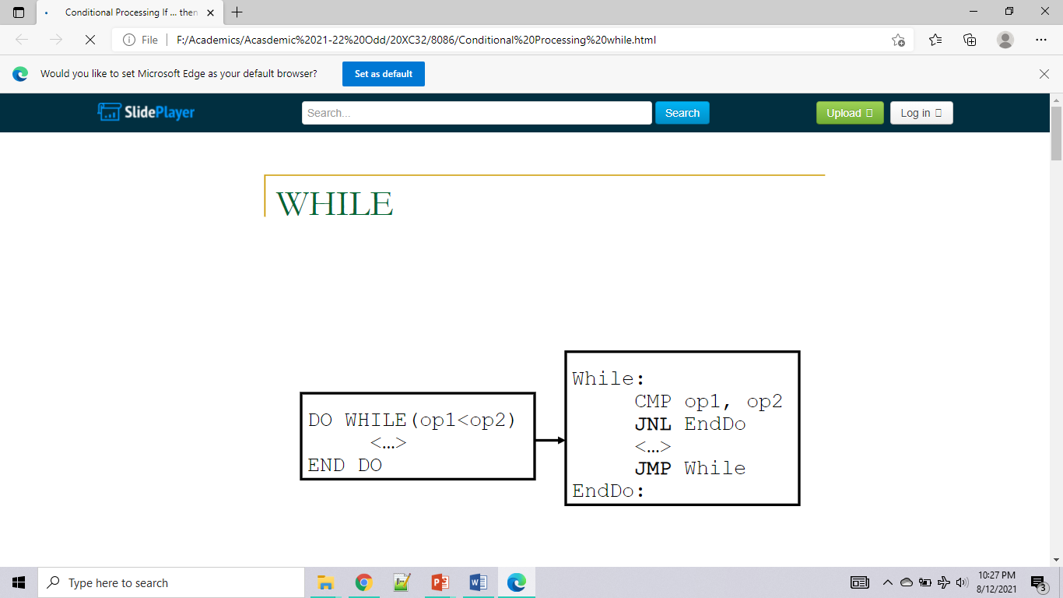
WHILE

Slide 18
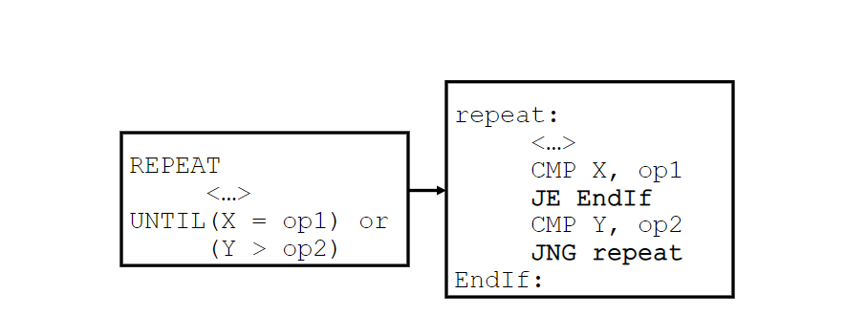
REPEAT …UNTIL

Slide 19
Control Transfer Instructions
These instructions transfer the program control from one address to other address. (Not in a sequence). They are again classified into four groups. They are:
Unconditional Transfer Instructions | Conditional Transfer Instructions |  | Iteration Control Instructions | Interrupt Instructions
JMP CALL RET | JA / JNBE JAE / JNB JB / JNAE JBE / JNA JC JE / JZ JG / JNLE JGE / JNL JL / JNGE | JLE / JNG JNC JNE / JNZ JNO JNP / JPO JNS JO JP / JPE JS | LOOP LOOPE / LOOPZ LOOPNE/LOOPNZ | INT INTO IRET
19
Notes:
Microprocessor Eng./Third Class (C)
Lecture 7
19
13/12/2017

Slide 20
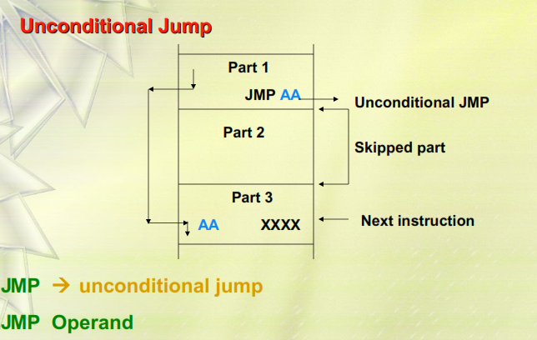
JUMP Instruction
8086 allows two types of jump operation. They are the unconditional jump and the conditional jump.
20
Notes:
Microprocessor Eng./Third Class (C)
Lecture 7
20
13/12/2017

Slide 21
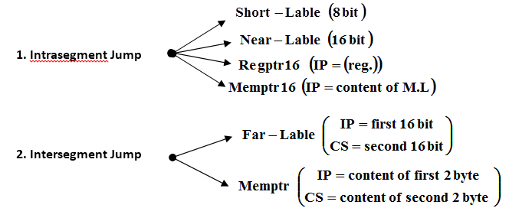
Unconditional Jump
There are two basic kinds of unconditional jumps:
Intrasegment Jump | Intersegment Jump
is limited to addresses within the current code segment | permit jumps from one code segment to another
achieved by just modifying the value in IP | requires modification of the contents of both CS and IP.
Short, Near | Far
Intrasegment Jump
Intersegment Jump
21
Notes:
Microprocessor Eng./Third Class (C)
13/12/2017
Lecture 7
21

Slide 22
Example 1
Assume the following state of 8086: (CS)=1075H, (IP)=0300H, (SI)=A00H, (DS)=400H, (DS:A00)=10H, (DS:A01)=B3H, (DS:A02)=22H, (DS:A03)=1AH. To what address is program control passed if each of the following JMP instruction is execute?
(a) JMP 85 ⇒ 1075:85 ⇒ Short jump
(b) JMP 1000H ⇒ 1075:1000 ⇒ Near jump
(c) JMP [SI] ⇒ 1075: B310 ⇒ Near jump
(d) JMP SI ⇒ 1075: 0A00 ⇒ Near jump
(e) JMP FAR [SI] ⇒ 1A22: B310 ⇒ Far jump
(f) JMP 3000:1000 ⇒ 3000:1000 ⇒ Far jump
22

Slide 23
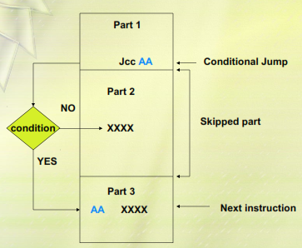
Conditional Jump
The conditional jump instructions test the following flag bits: S, Z, C, P, and O. If the condition under test is true, a branch to the label associated with jump instruction occurs. If the condition is false, the next sequential step in the program executes.
23

Slide 24
Unsigned Conditional Transfers
Mnemonic | Meaning “Jump if….. ” | Condition Tested
JA/JNBE | above/not below nor equal | (CF or ZF) = 0
JAE/JNB | above or equal/not below | CF = 0
JB/JNAE | below/not above nor equal | CF = 1
JBE/JNA | below or equal/not above | (CF or ZF) = 1
JC | Carry | CF = 1
JE/JZ | equal/zero | ZF = 1
JNC | not carry | CF = 0
JNE/JNZ | not equal/not zero | ZF = 0
JNP/JPO | not parity/parity odd | PF = 0
JP/JPE | parity/parity even | PF = 1
JCXZ | CX register is zero | CF or ZF = 0
24

Slide 25
Signed Conditional Transfers
Mnemonic | Meaning “Jump if….. ” | Condition Tested
JG/JNLE | greater/not less nor equal | ((SF xor OF) or ZF) = 0
JGE/JNL | greater or equal/not less | (SF xor OF) = 0
JL/JNGE | less/not greater nor equal | (SF xor OF) = 1
JLE/JNG | less or equal/not greater | ((SF xor OF) or ZF) = 1
JNO | not overflow | OF = 0
JNS | not sign (positive, including 0) | SF = 0
JO | Overflow | OF = 1
JS | sign (negative) | SF = 1
25
AX before

Slide 26
Example 2: Write a program to move a block of 100 consecutive bytes of data starting at offset address 400H in memory to another block of memory locations starting at offset address 600H. Assume both block at the same data segment F000H. Use Jump instruction.
Solution:
MOV AX, F000H
MOV DS, AX
MOV SI, 0400H
MOV DI, 0600H
MOV CX, 64H
NXT: MOV AH, [SI]
MOV [DI], AH
INC SI
INC DI
DEC CX
JNZ NXT
HLT
Direction Flag=0, CLD
DS=F000H
ES=F000H
SI=0400H
DI=0600H
Counter=CX=64H=100byte
26
AX before

Slide 27
Example 3: Write a program to add (50)H numbers stored at memory locations start at 4400:0100H , then store the result at address 200H in the same data segment.
Solution:
MOV AX , 4400H
MOV DS , AX
MOV CX , 0050H
MOV SI , 0100H
XOR AL,AL ; or (MOV AL, 00H)
Again: ADD AL, [BX]
INC SI
DEC CX
JNZ Again
MOV [0200], AL ; or (MOV [DI] , AL)
Direction Flag=0, CLD
DS=4400H
ES=4400
SI=0100H
DI= 0200
Counter=CX=50H
27
Notes:
Microprocessor Eng./Third Class (C)
Lecture 7
27
13/12/2017

Slide 28
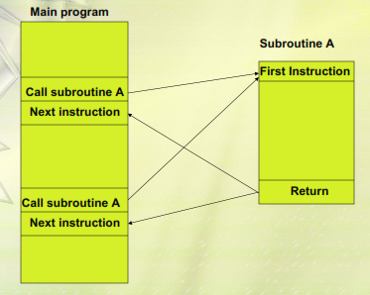
SUBROUTINE & SUBROUTINE HANDILING INSTRUCTIONS
28

Slide 29
CALL and RET Instructions
A subroutine is a special segment of program that can be called for execution form any point in program.
There two basic instructions for subroutine : CALL and RET
CALL instruction is used to call the subroutine.
RET instruction must be included at the end of the subroutine to initiate the return sequence to the main program environment.
Just like the JMP instruction, CALL allows implementation of two types of operations: the intrasegment call and intersegment call.
Every subroutine must end by executing an instruction that returns control to the main program. This is the return (RET).
Execution of RET instruction at the end of the subroutine causes the original values of IP and CS to be POPed from stack
29

Slide 30
CALL and RET Instructions
The operand of the call instruction initiates an intersegment or intrasegment call
The intrasegment call causes contents of IP to be saved on Stack.
The Operand specifies new value in the IP that is the first instruction in the subroutine.
The Intersegment call causes contents of IP and CS to be saved in the stack and new values to be loaded in IP and CS that identifies the location of the first instruction of the subroutine.
Intrasegment CALL | Intersegment CALL
is limited to addresses within the current code segment | permit jumps from one code segment to another
achieved by just modifying the value in IP | requires modification of the contents of both CS and IP.
Short, Near | Far
30

Slide 31
Example5: write a procedure named Square that squares the contents of BL and places the result in BX.
Solution:
Square: PUSH AX
MOV AL, BL
MUL BL
MOV BX, AX
POP AX
RET
Example6: write a program that computes y = (AL)² + (AH)² + (DL)² , places the result in CX. Make use of the SQUARE subroutine defined in the previous example. (Assume result y doesn’t exceed 16 bit)
Solution:
MOV CX, 0000H
MOV BL,AL
CALL Square
ADD CX, BX
MOV BL,AH
CALL Square
ADD CX, BX
MOV BL,DL
CALL Square
ADD CX, BX
HLT
31

